Slide 1
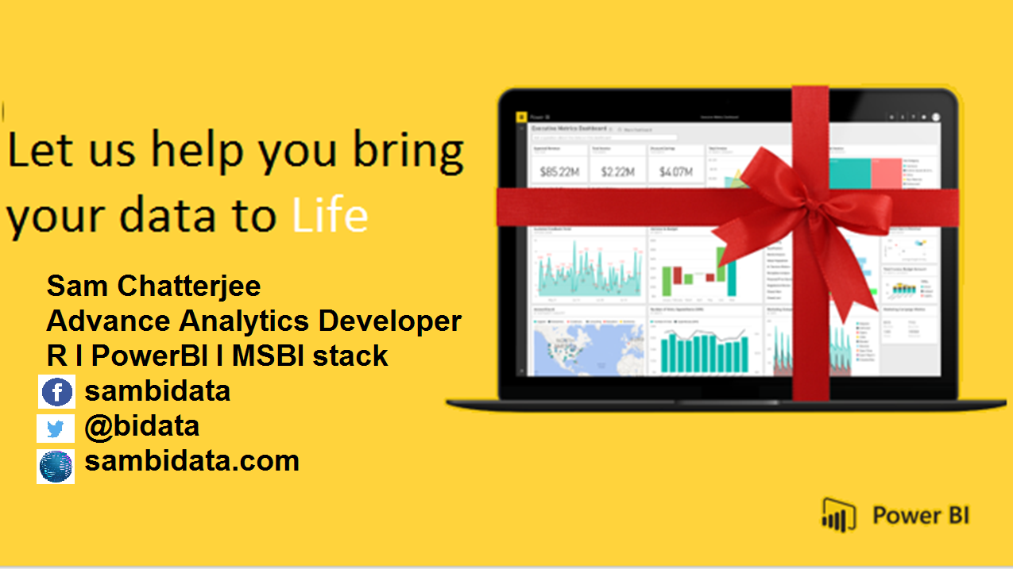

Slide 2


Let’s Create PowerBI Dashboard.
Where do I START?

Slide 3
Let’s Create PowerBI from Scratch to Dashboard.
Slicers in Power BI
When to use a slicer
Slicers are a great choice when you want to:
Display commonly-used or important filters on the report canvas for easier access.
Make it easier to see the current filtered state without having to open a drop-down list.
Filter by columns that are unneeded and hidden in the data tables.
Create more focused reports by putting slicers next to important visuals.
Power BI slicers have the following limitations:
Slicers do not support input fields.
Slicers cannot be pinned to a dashboard.
Drilldown is not supported for slicers.
Slicers do not support visual level filters.

Slide 4
Let’s Create PowerBI from Scratch to Dashboard.
Create slicers
To create a new slicer, you can select the slicer icon and then select the data field to filter on (or drag it to the Fields box in the Visualizations pane), or you can select or drag the data field first to create a visualization, and then select the slicer icon to turn the visualization into a slicer. Different data types create different types of slicers, with different effects and options.
The first time you change a report, the button for Reset to default lights up. This is a reminder that you've made a change to the original report settings. If you navigate away from the report, that change is saved (persists). When you return to the report you don't have to re-slice the report. However, if you'd like to reset the report to the author's default settings, select the Reset to defaultbutton from the top menubar.

Slide 5
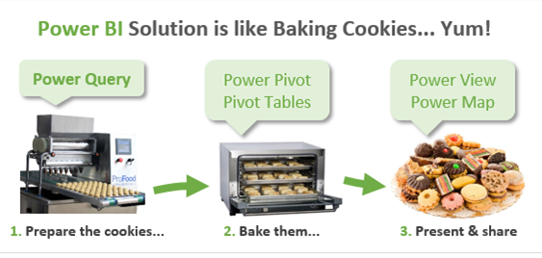


Slide 6
Downloads
To install PowerBI from Microsoft
https://powerbi.microsoft.com/en-us/desktop/?WT.mc_id=Blog_Desktop_Update
Microsoft One drive
https://onedrive.live.com/?authkey=%21AAgrneBx3oI8Rak&id=B5A9CCD6892588B1%21423&cid=B5A9CCD6892588B1
Microsoft Onedrive data sets
https://onedrive.live.com/?id=7B84B0F2C239489A%212078&cid=7B84B0F2C239489A

Slide 7




Resources
Get Power BI (Free) http://tinyurl.com/hj5hdg6
Power BI Jump Start http://bit.ly/1ktON16
Power BI Getting Started http://bit.ly/1FF88KA
Power BI Team Blog http://bit.ly/1vwbTLG
Power BI Channel 9 http://bit.ly/1a9Q0gv
Power BI https://powerbi.microsoft.com

Slide 8
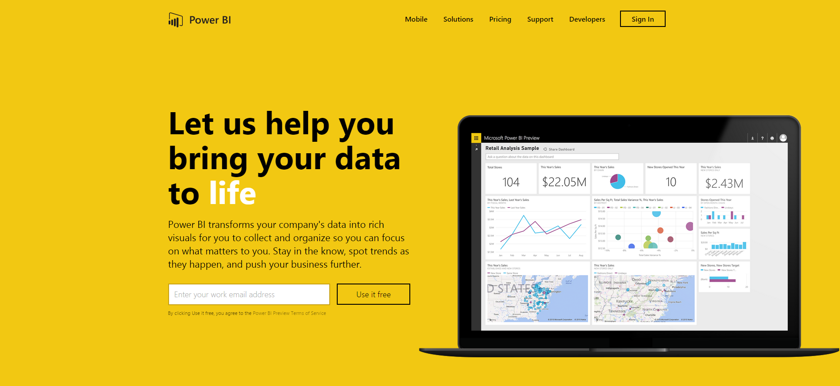
Thankyou for Coming to PowerBI
Sign up for a free Preview account
Take the Power BI Tour
Notes:
Thanks for taking the time to walk through the main capabilities of Power BI.
If you’re ready to start exploring what Power BI can do for you and your organization, please visit powerbi.com.

